Slide 1
Coca-Cola’s Sales vs Cultural effects
Jenna Nowland

Slide 2
01
Background

Slide 3
AGENDA
01
BACKGROUND
04
For the Future
INBM
Quantifying Culture
Regions / Countries
Things to consider
02
VISUALIZATIONS
05
CLOSING
Strategy
Coca-Cola Sales
Heat-Maps
K-Clustering
Thank You
03
ANALYZING
Findings
Answer

Slide 4
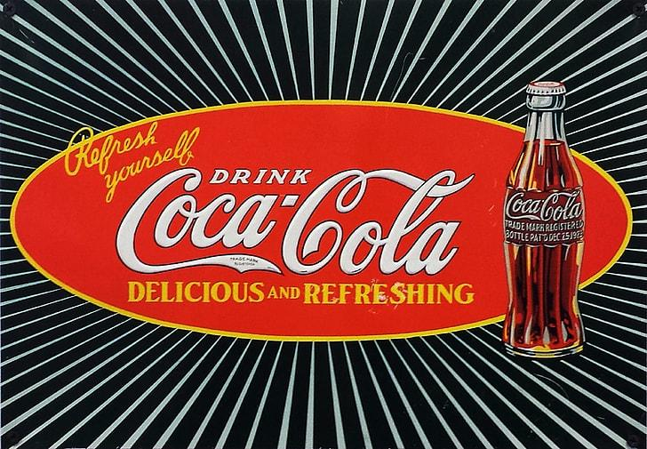
Culture across countries/regions has an effect on consumption.
Decided to look into a large, American brand to see if international sales can be explained by that country’s cultural emphases.
Three Track Sequence
International Business and Management

Slide 5
PDI
Power Distance
Accept and expect unequal power distribution
IDV
Individualism
Emphasis on person’s self-reliance - personal goals over group.
MTS
Motivation towards Achievements and Success
UAI
Uncertainty Avoidance
Avoid ambiguity with strict rules, structure, and predictability.
Long Term Orientation
Prioritize planning and future-focus
Indulgence
Prioritize leisure, human impulses, personal desires and needs.
Quantifying Culture
Five Categories (0-100 scale)
LTO
IVR

Slide 6
Regions / Countries
Analyzed top Coca-Cola consumers by region
North America
Latin America
United States of America
Canada
Mexico
Brazil
Europe
Asia-Pacific
United Kingdom
Germany
Spain
China
India
Japan

Slide 7
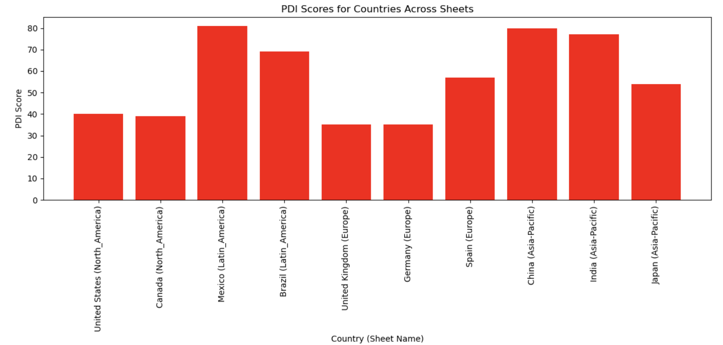
Visualizing Culture across Countries
Power Distance

Slide 8
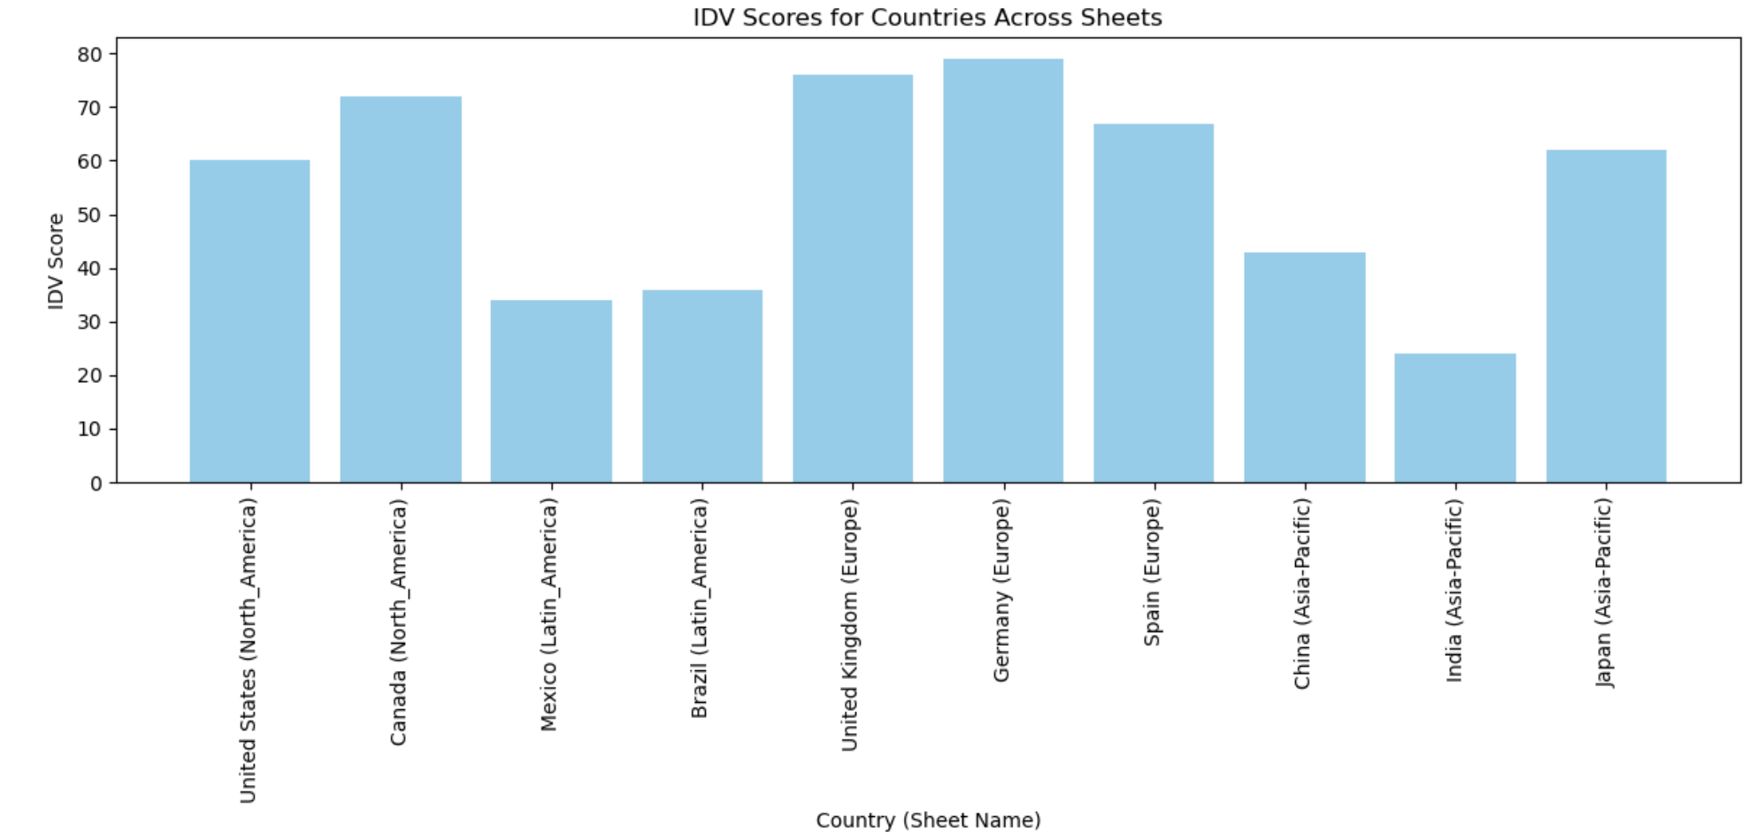
Visualizing Culture across Countries
Individualism

Slide 9
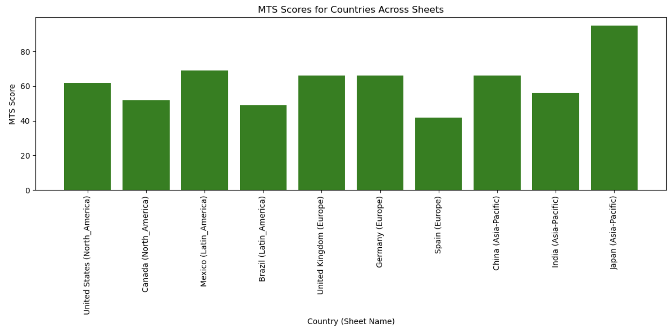
Visualizing Culture across Countries
Motivation towards Achievement and Success

Slide 10
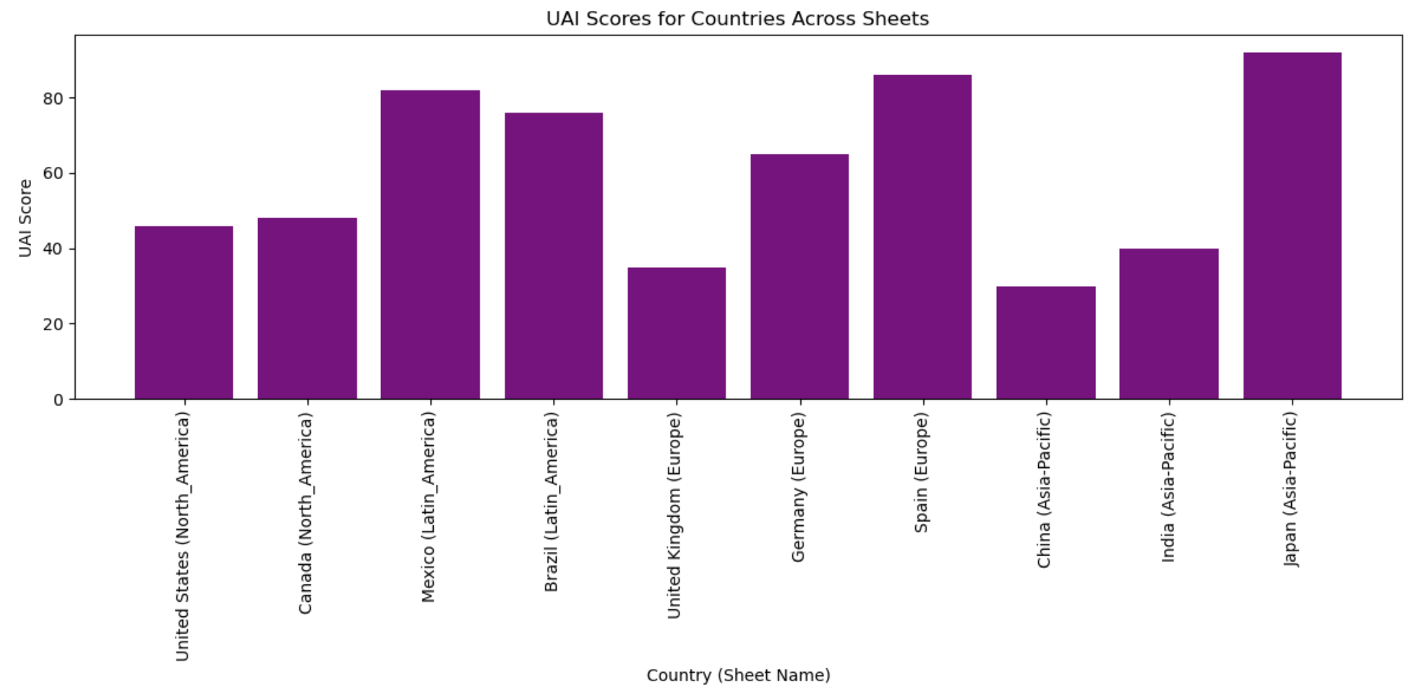
Visualizing Culture across Countries
Uncertainty Avoidance

Slide 11
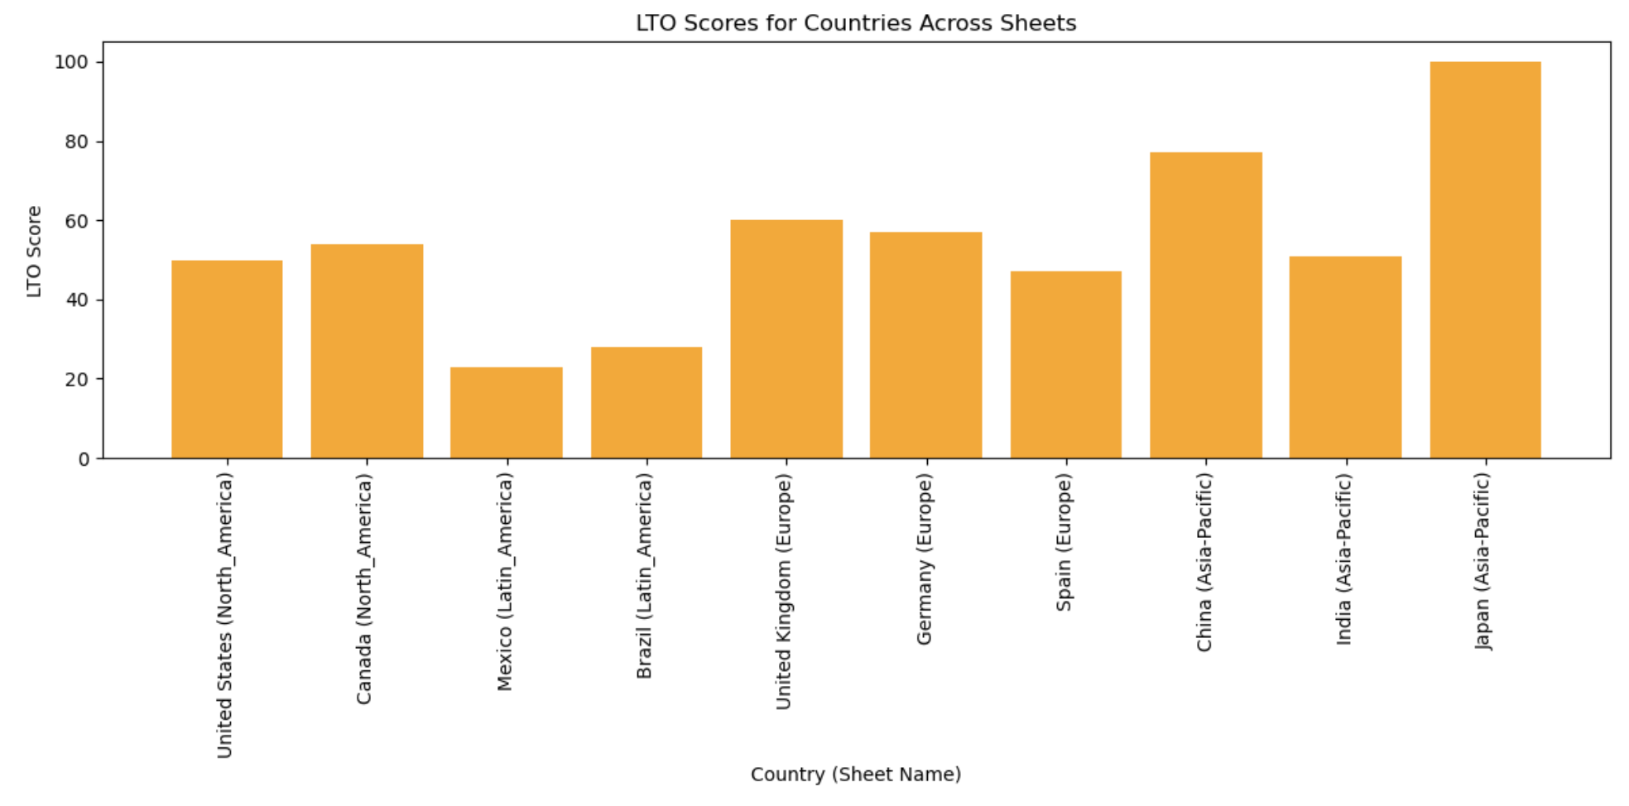
Visualizing Culture across Countries
Long Term Orientation

Slide 12
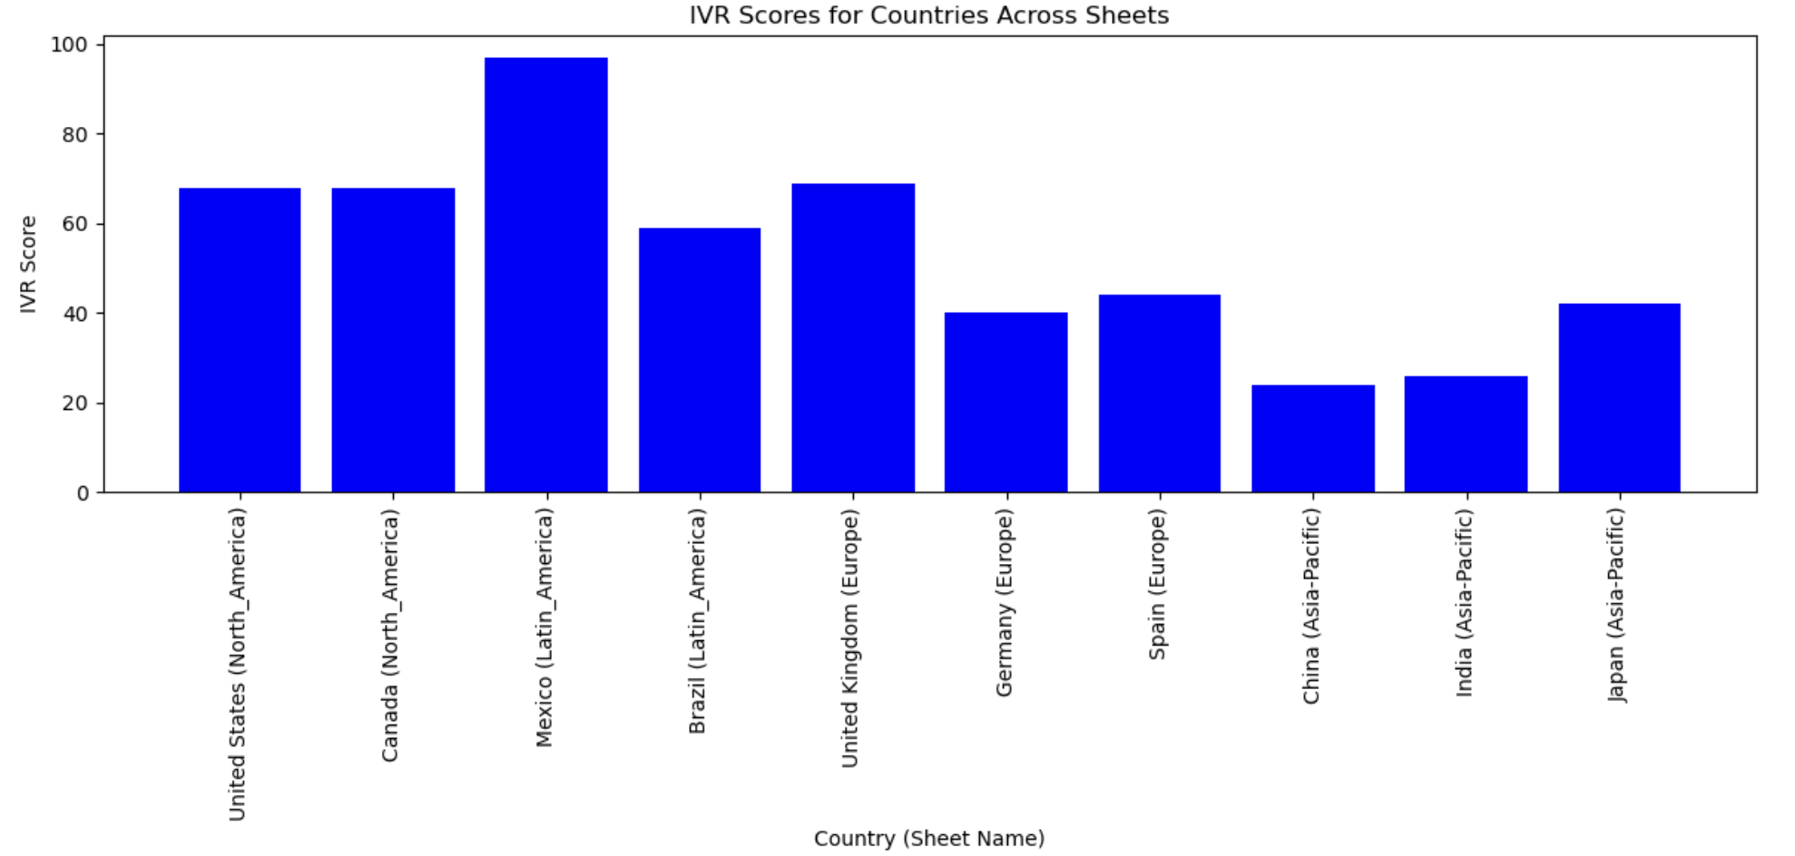
Visualizing Culture across Countries
Indulgence

Slide 13
02
Visualizations

Slide 14
Bar Graphs
Heat Maps
K-Means Clustering
Visualizing
ONLY considered dark, sugar soda (Coca-Cola), not tea, coffee, etc.
Cultural Variables
AVG monthly/annual income
Total Country GDP
Factors Considered
Weaknesses
Data set size (10 countries)
Time constraint
Outside Influences
Populations Size
How quantifiable is culture..?
Strategy / Considerations

Slide 15
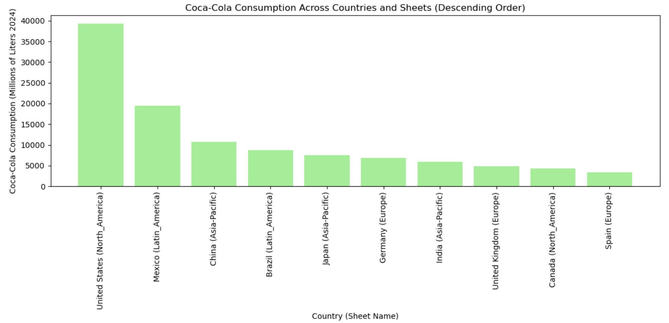
Coca-Cola Consumption (DESC order)

Slide 16
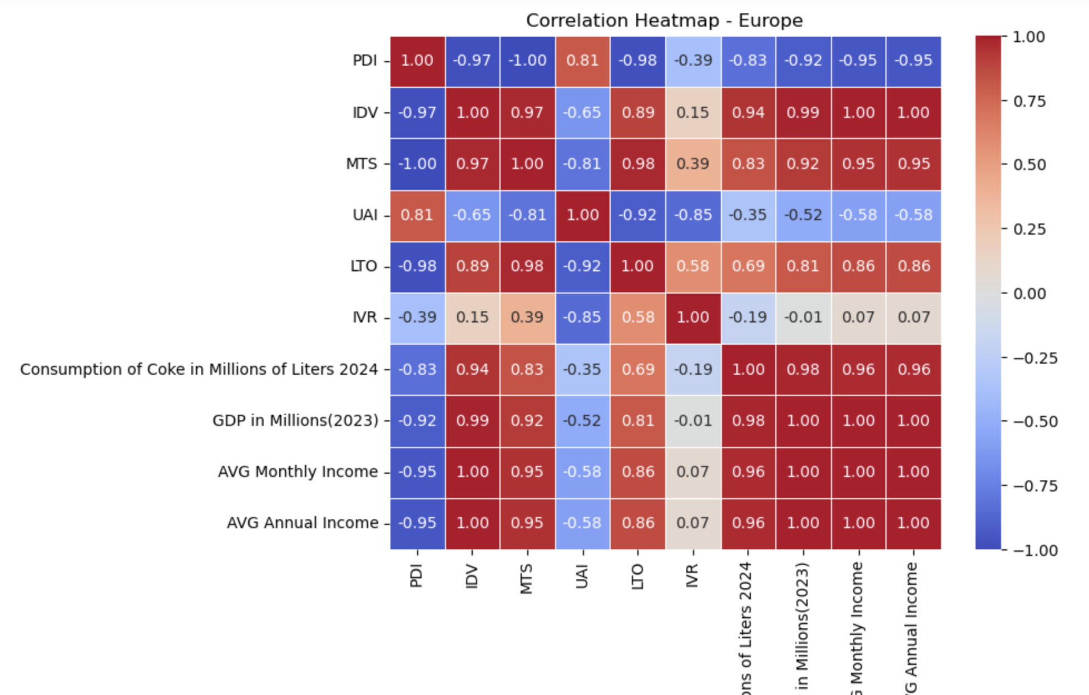
Heat map Analysis - Europe

Slide 17
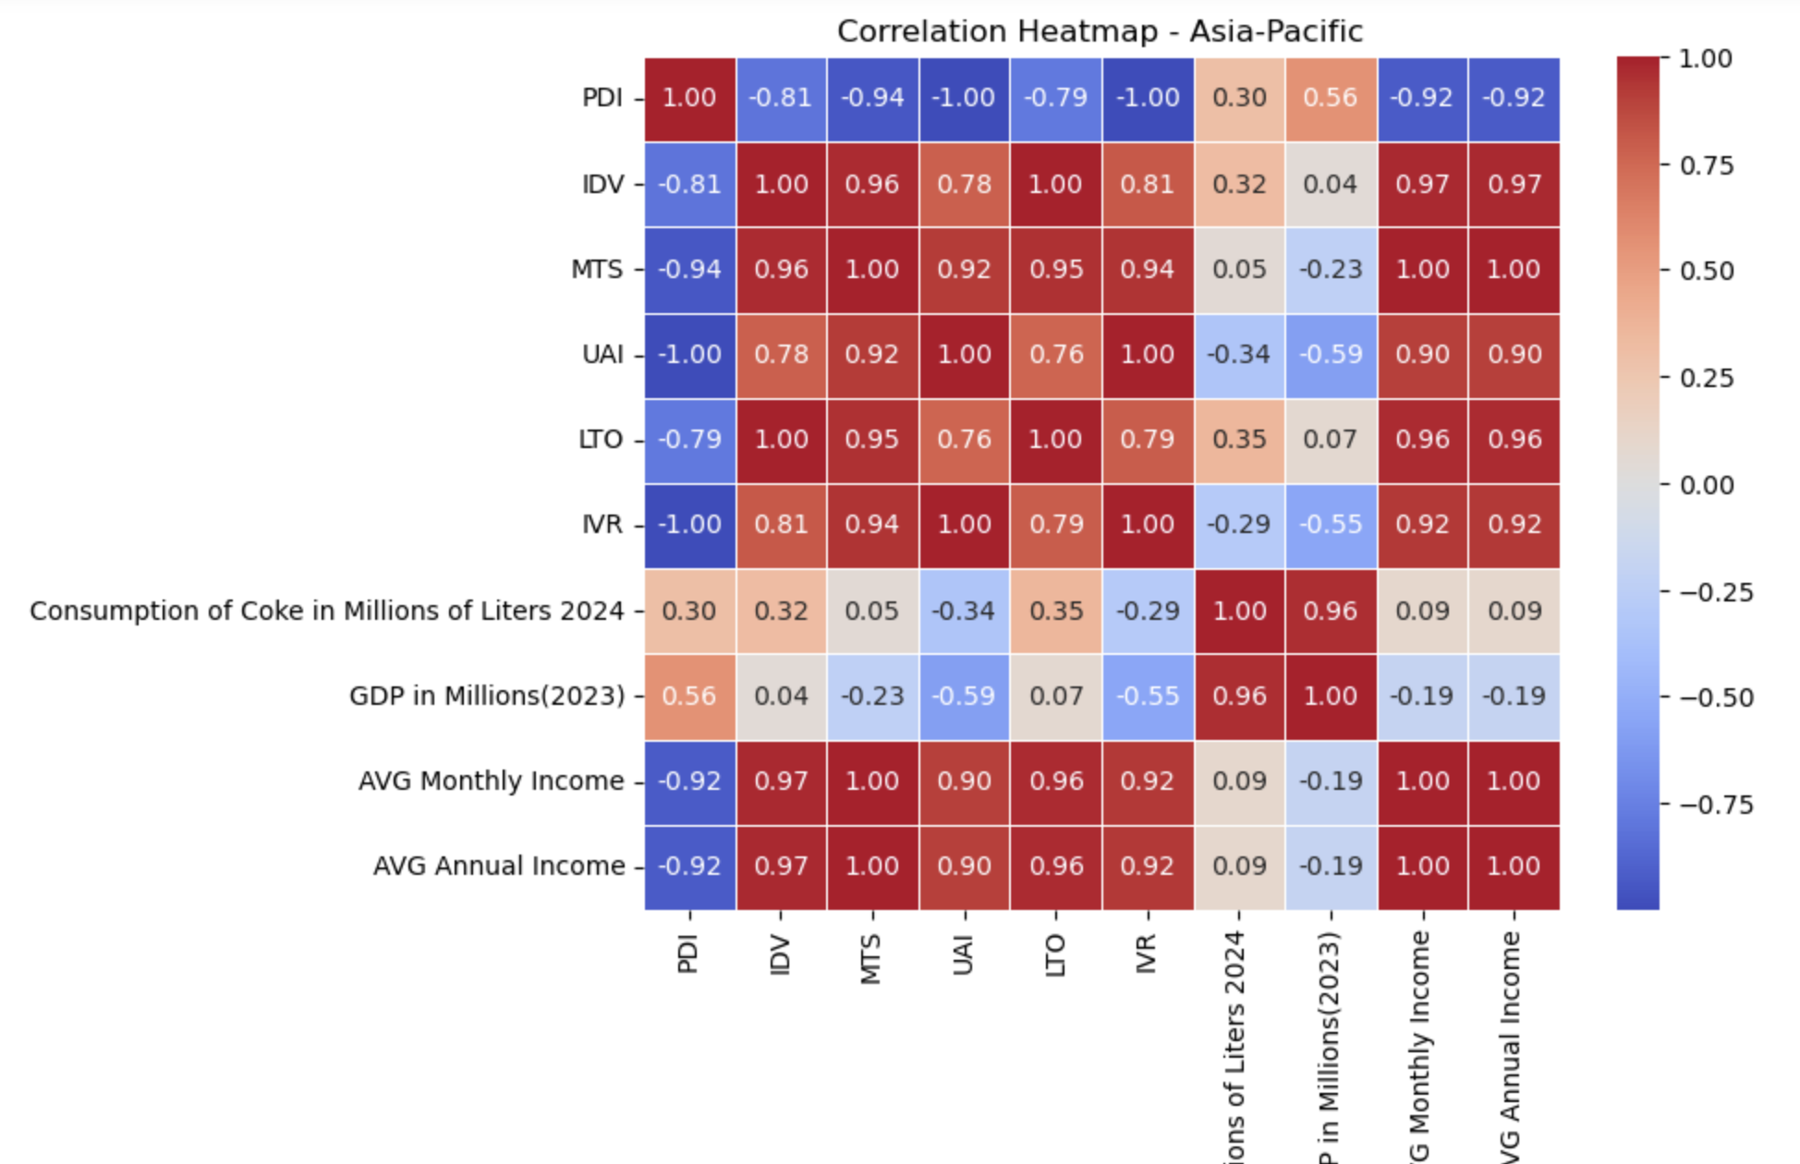
Heat map Analysis - Asia-Pacific

Slide 18
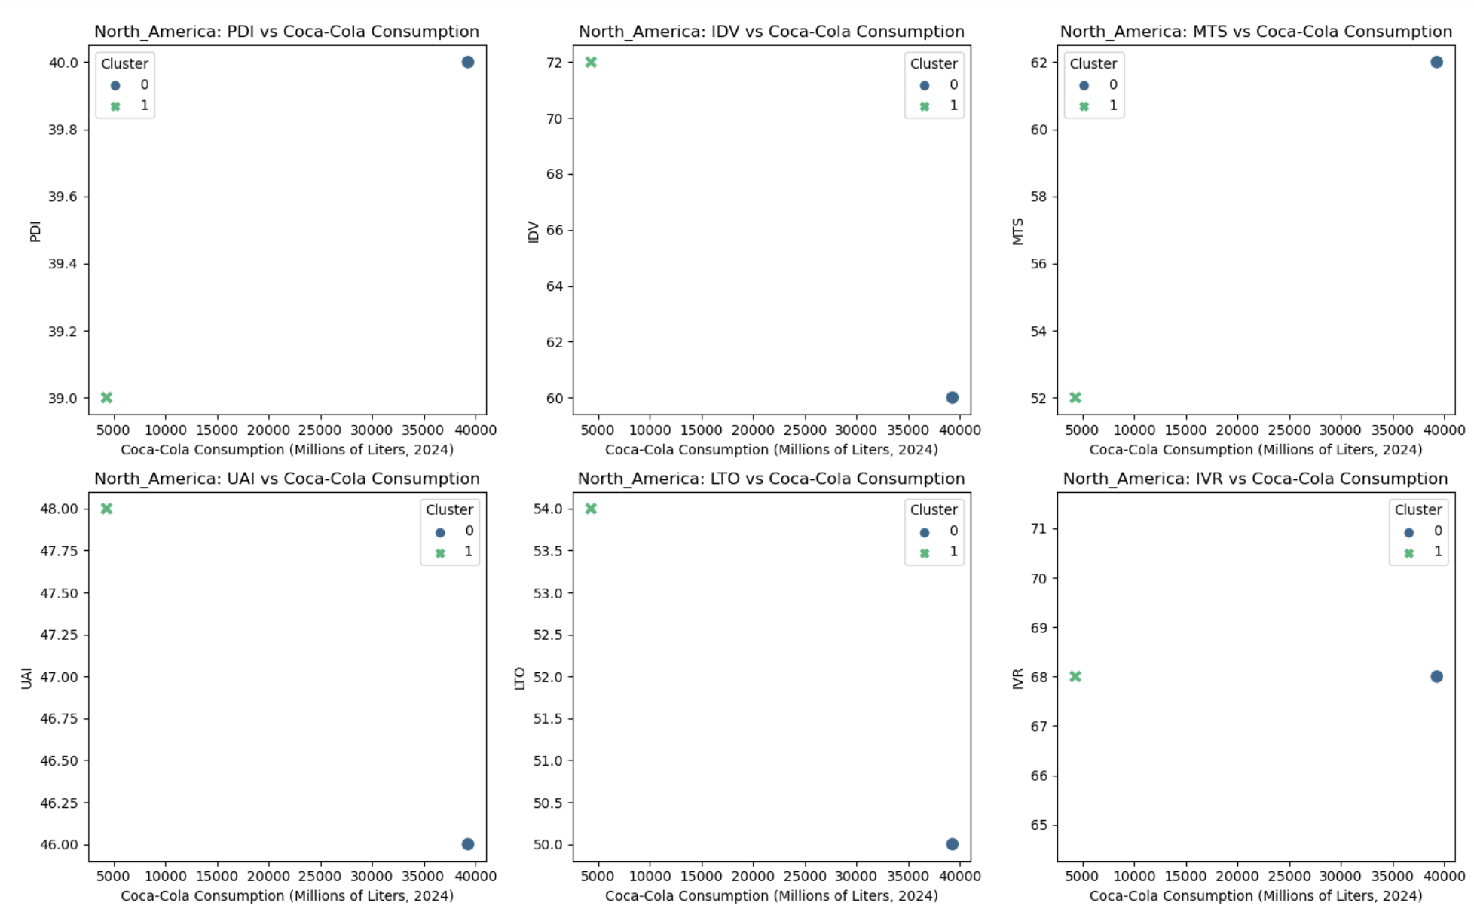
NA Cluster
US-0
CA -1

Slide 19
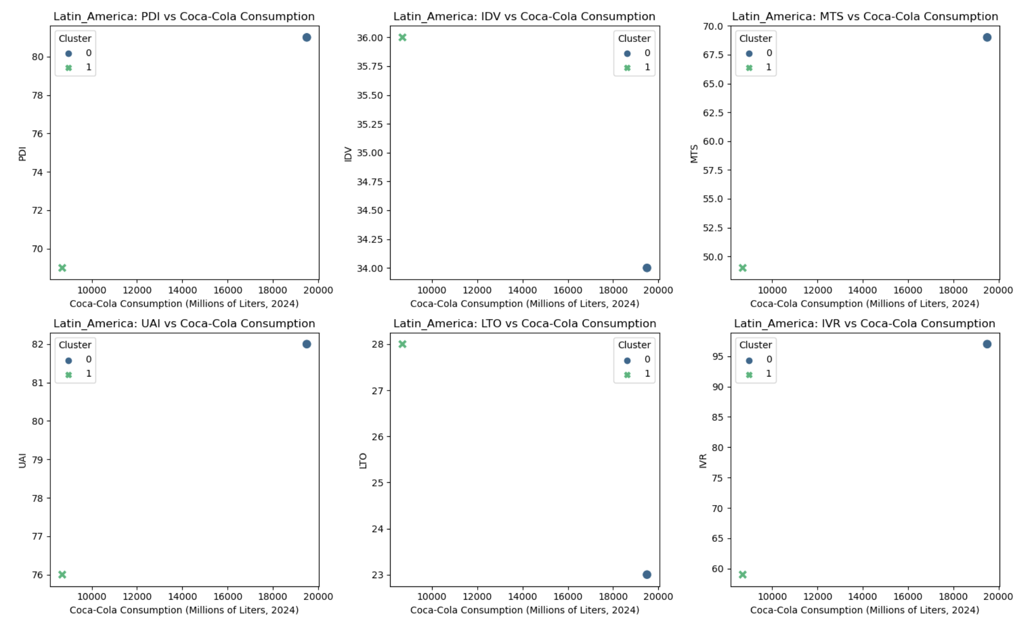
LA Cluster
MX-0
BZ -1

Slide 20
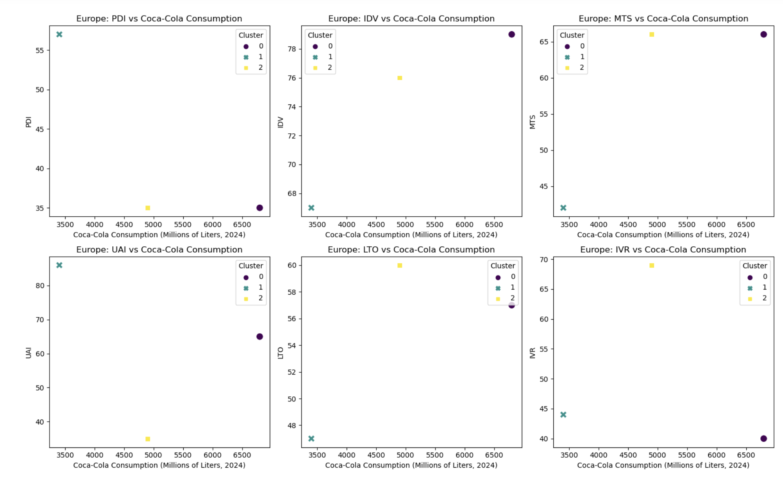
EU Cluster
GR-0
Sp-1
UK-2

Slide 21
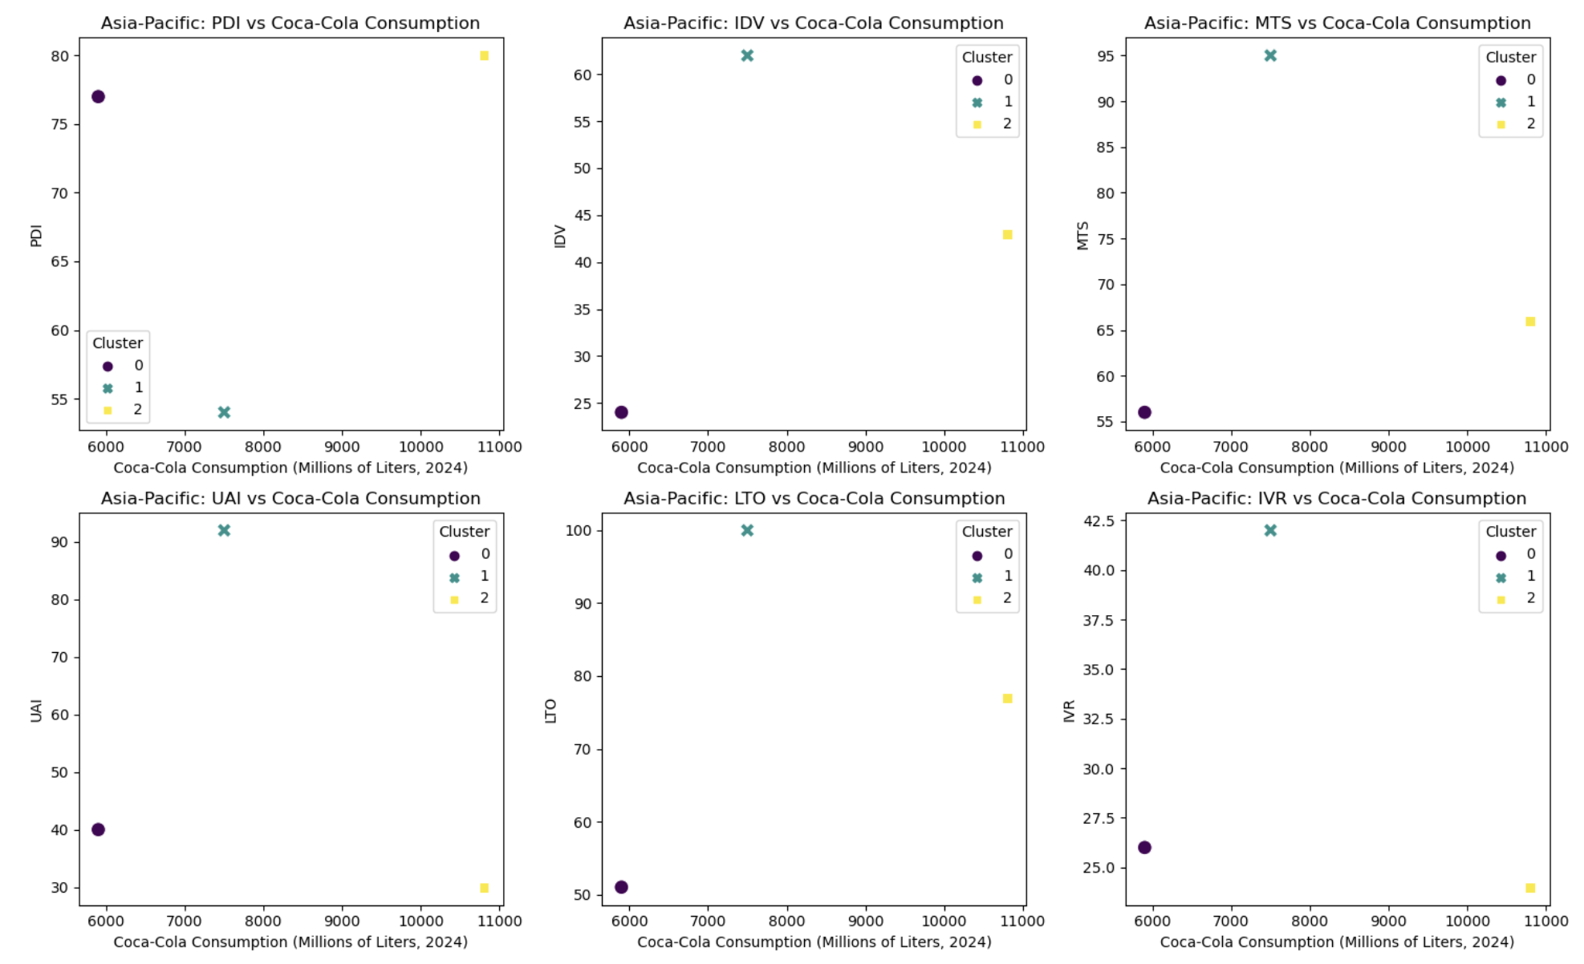
AP Cluster
IN-0
JA-1
CH-2

Slide 22
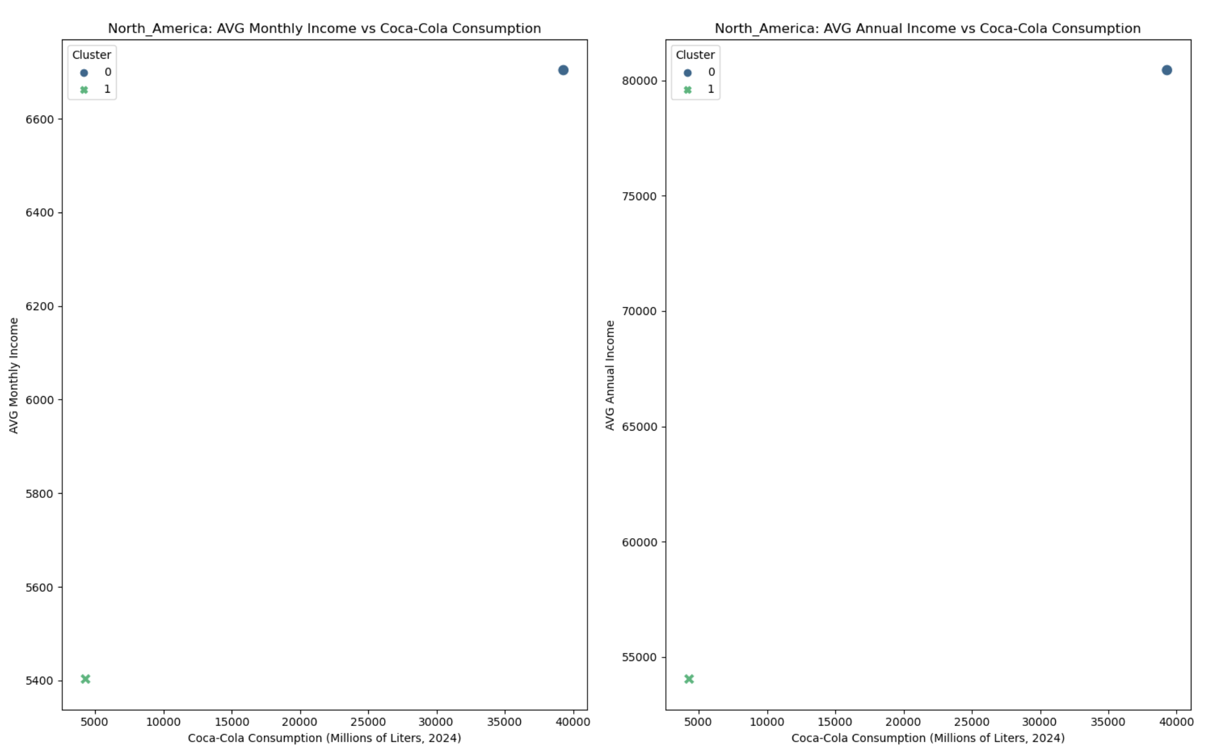
NA Income Cluster
US-0
CA-1

Slide 23
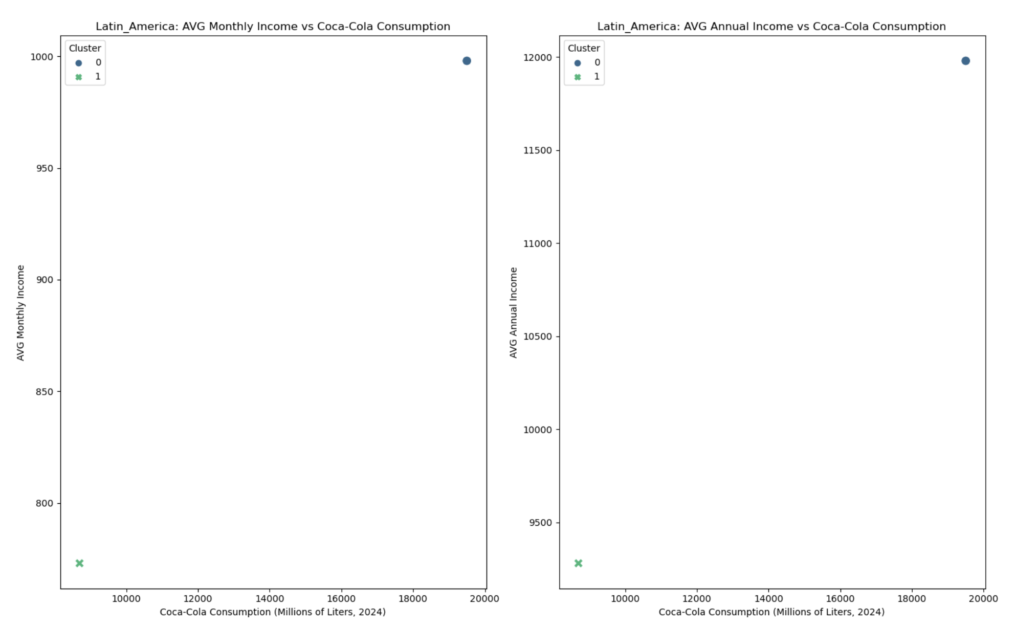
LA Income Cluster
MX-0
BZ-1

Slide 24
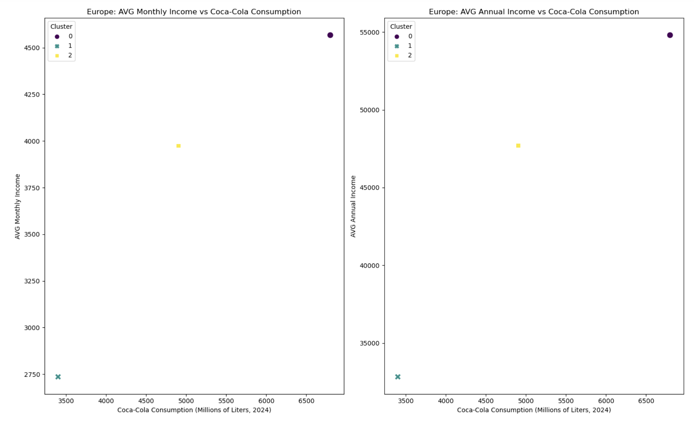
EU Income Cluster
GR-0
SP-1
UK-2

Slide 25
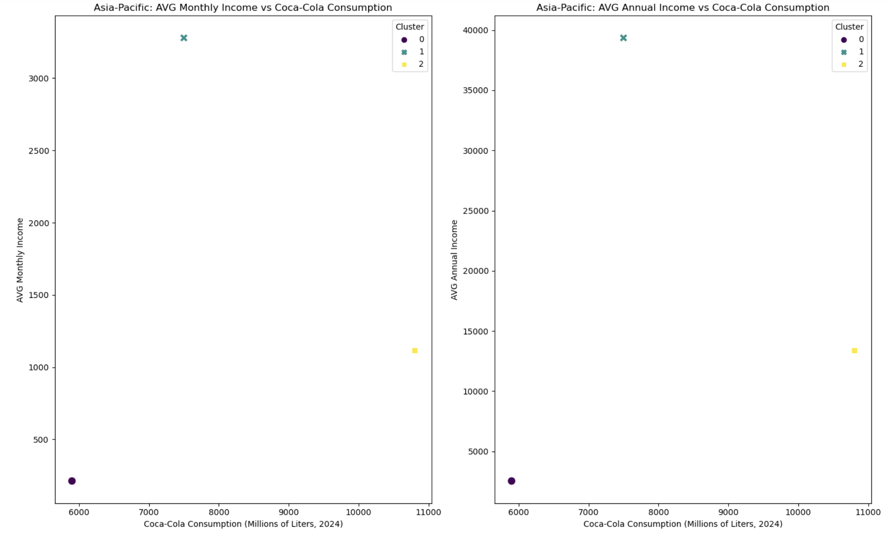
AP Income Cluster
IN-0
JP-1
CH-2

Slide 26
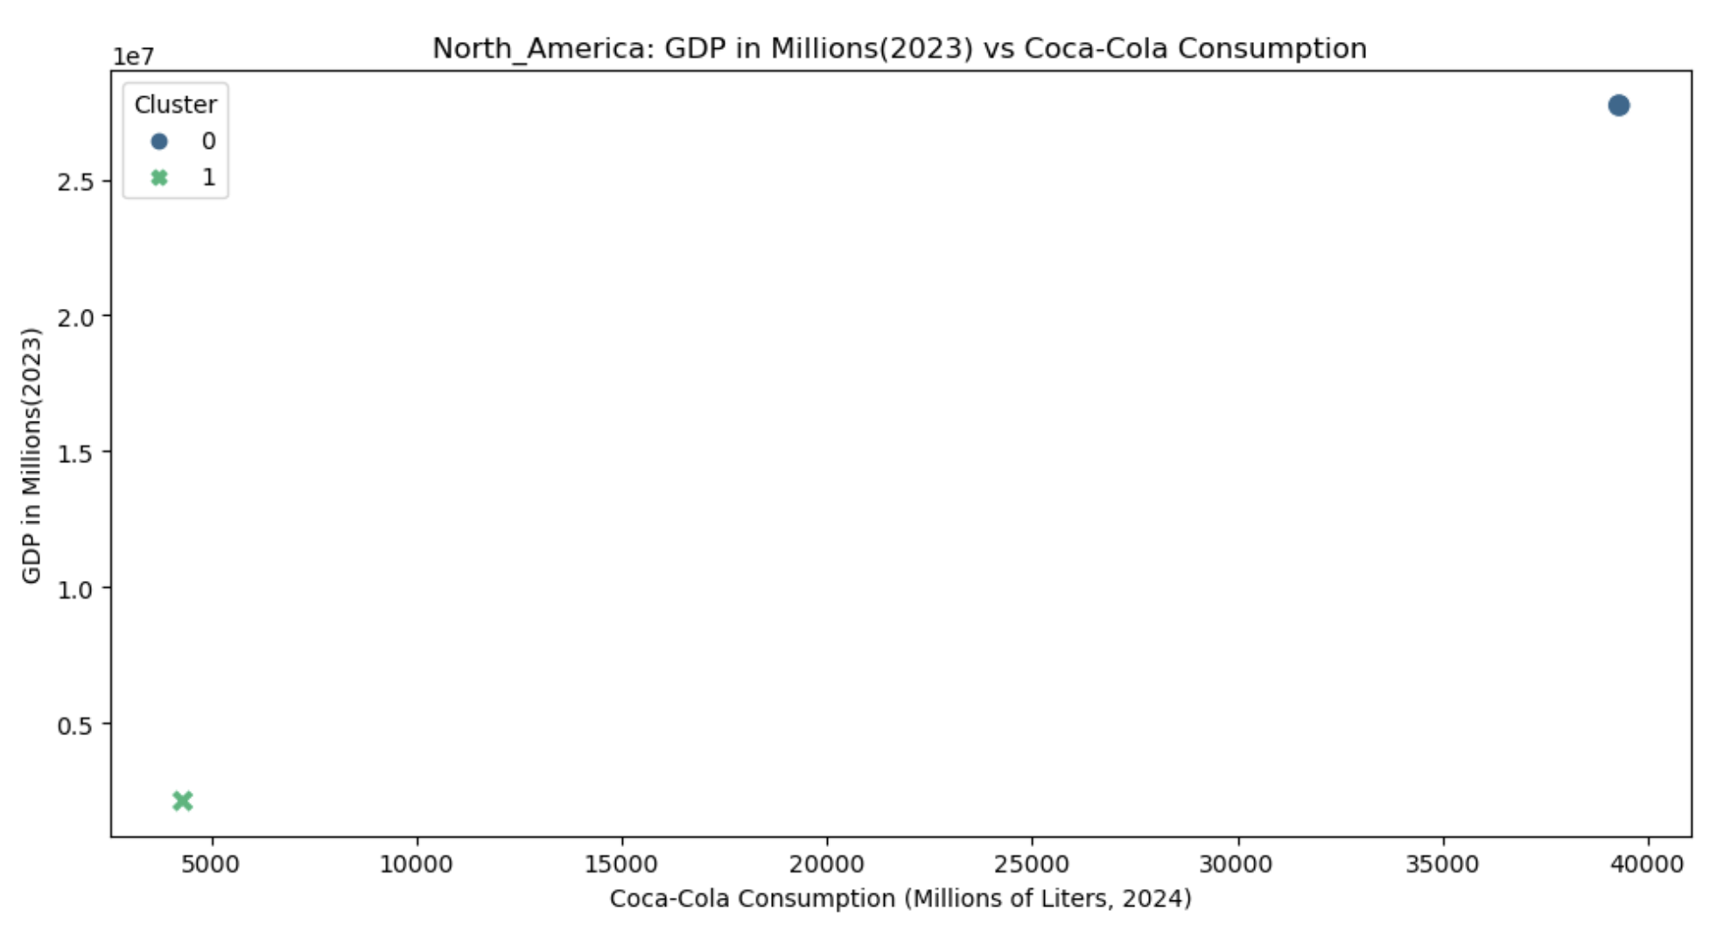
NA Income Cluster (Total GDP)
US-0
CA-1

Slide 27
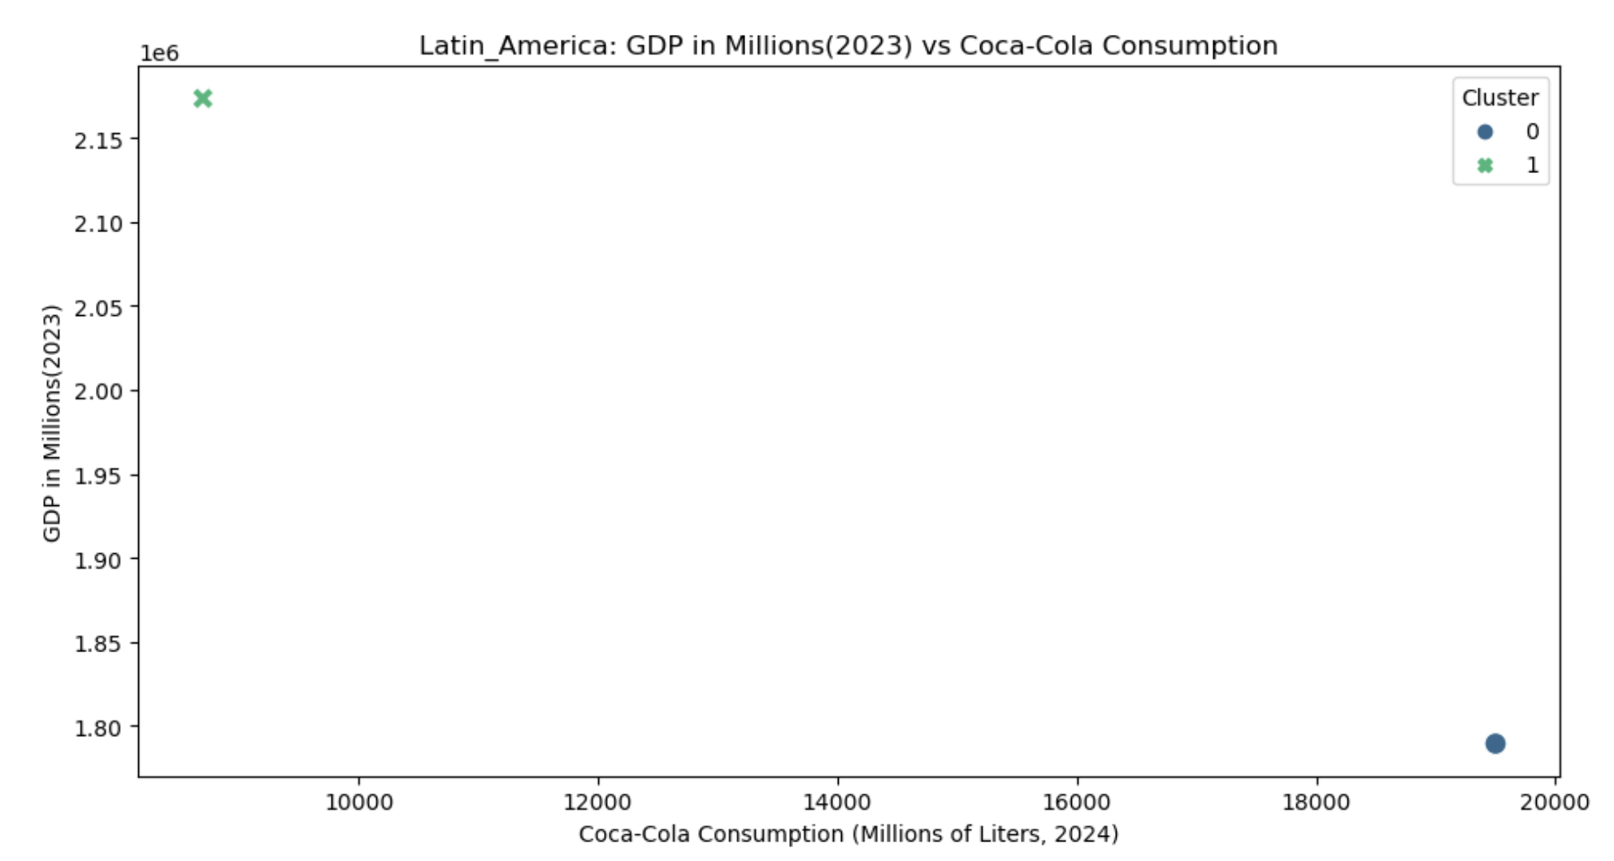
LA Income Cluster (Total GDP)
MX-0
BZ-1

Slide 28
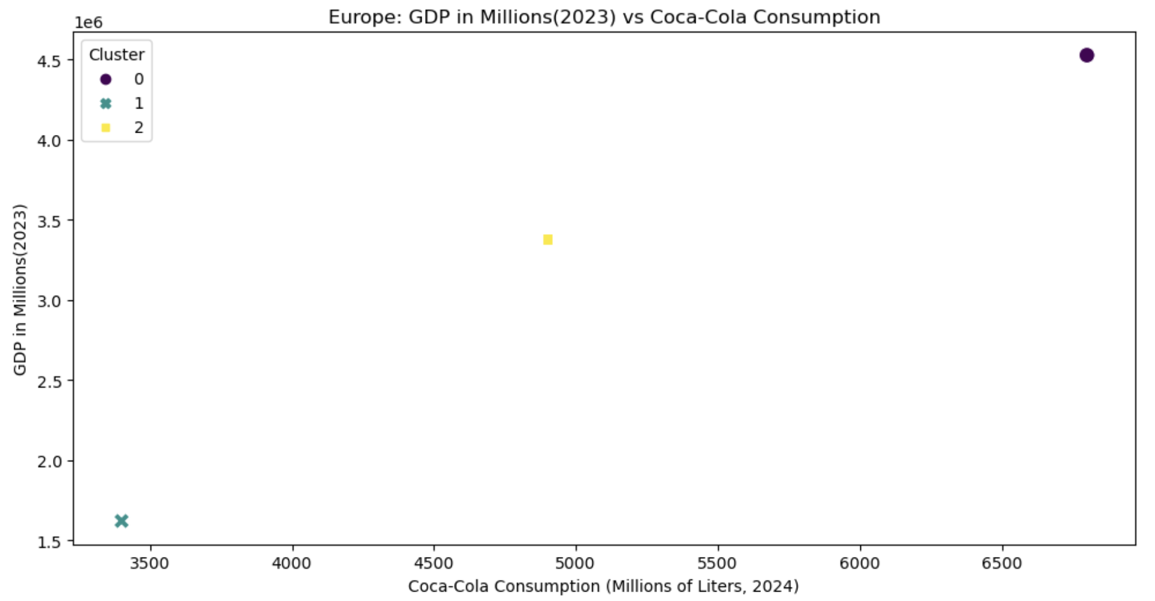
EU Income Cluster (Total GDP)
GR-0
SP-1
UK-2

Slide 29
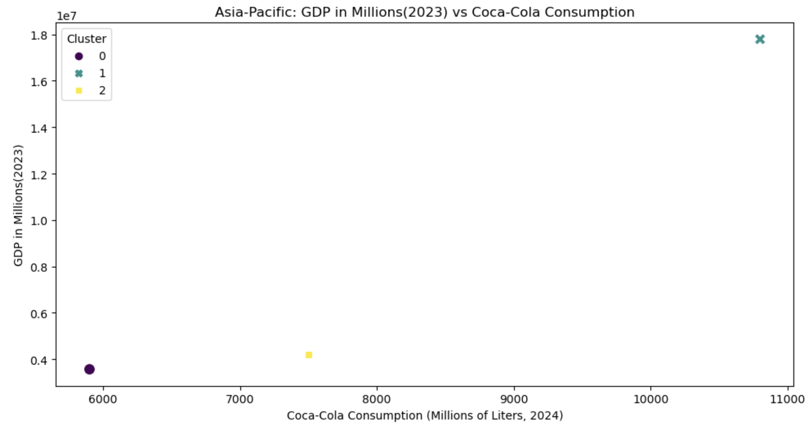
AP Income Cluster (Total GDP)
IN-0
CH-1
JP-2

Slide 30
03
ANALYZING

Slide 31
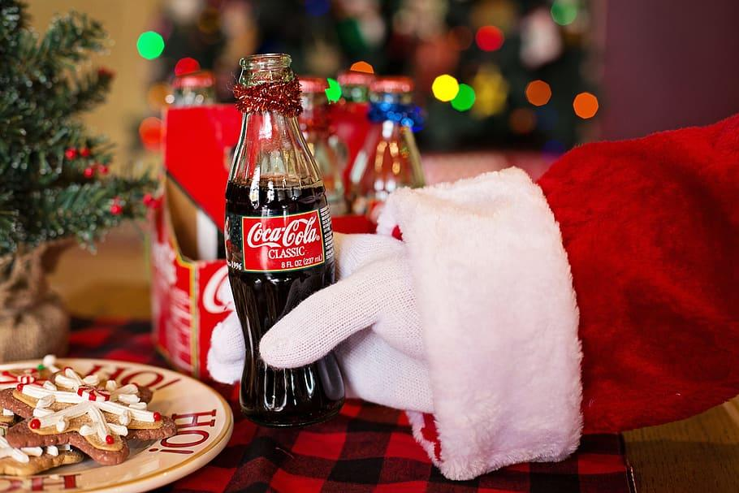
Findings:
Overall, AVG Annual Income, AVG Monthly Income, and Total GDP had a greater effect on Coca-Cola consumption than cultural emphases.
Highest cultural explanations: Europe’s Individualism translating to sales.
Asia-Pacific is hardest to identify a correlation.
Outside factors have a heavy influence.

Slide 32
Does Culture have a direct impact on Coca-Cola sales?
Although cultural impacts have some effect on the consumption of Coca-Cola, income and GDP have a much greater effect.
However, the findings of this question are important for stakeholders to understand how to respect a country’s culture as well as capitalize off something they would enjoy.

Slide 33
04
For the Future

Slide 34
Things to look into…
Larger Dataset
Finding other Factors
Consider increasing the data to more than 10 countries. This allows one to see more trends in a clearer way.
Thinking of other necessary factors which could affect Coca-Cola consumption. Such as: Population, marketing costs Coca-Cola spends in that country/region, availability of Coca-Cola, etc.
Quantifiable Culture
Explanations >> Assumptions
Culture is a hard thing to quantify. For example, a country that shames unhealthy habits may be more judgemental to witness someone drinking the sugary-soft drink.
It is important to note that some assumptions had to be made due to the time constraint. For example, if someone looked into other Coca-Cola products, the price of these products, etc.

Slide 35
THANK YOU
Jenna Nowland

